Slide 1
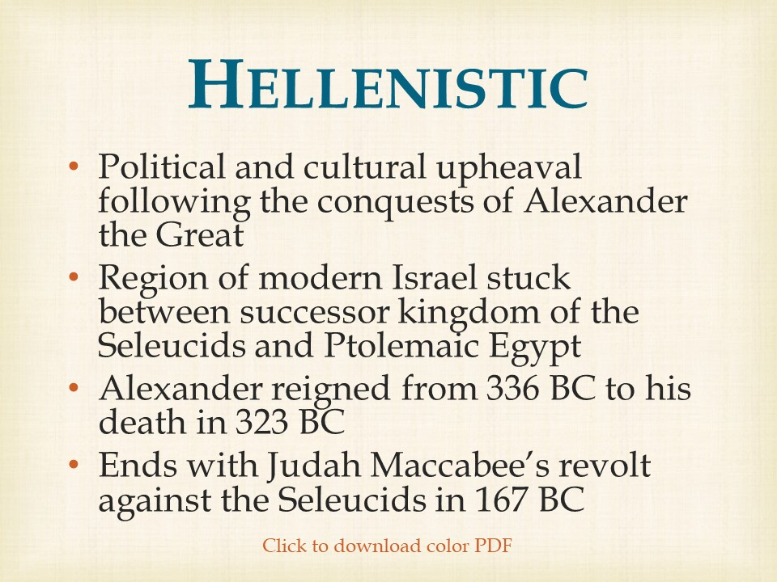

Slide 2
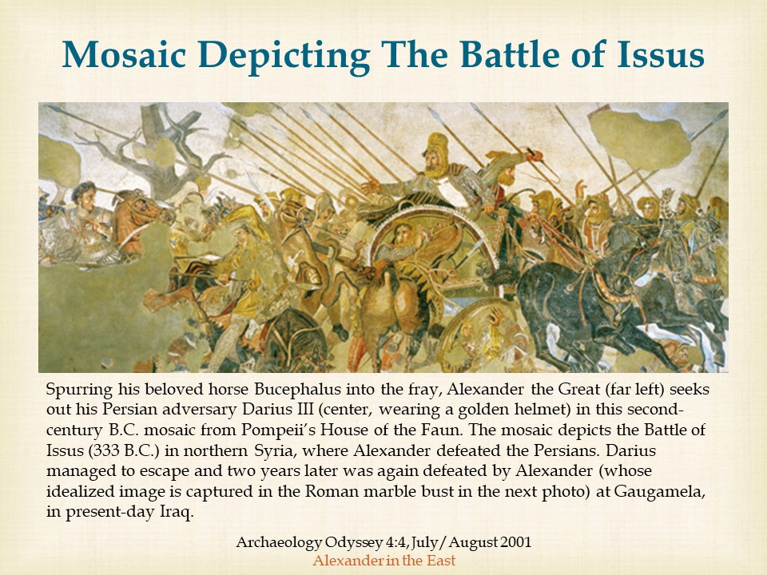

Slide 3
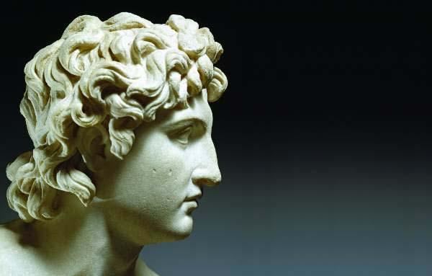
Judea under Alexander the Great
Biblical Archaeology Review 36:1, January/February 2010
Under the Influence
With the conquests of the Macedonian king Alexander the Great in the fourth century B.C.E., the populations of the Near East, including the Jews of Judea, began a thousand-year fascination with Greek culture. Although this fascination was often tempered by the political and military forays of Alexander’s successors (including the Romans), Jews from all walks of life readily embraced aspects of Greek culture.

Slide 4
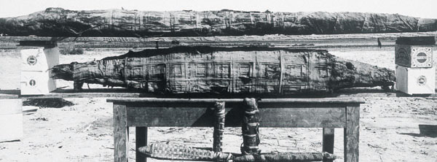
Tebtunis Papyri
Archaeology Odyssey 2:5, November/December 1999
Field Notes
In December 1899, Berkeley archaeologists Bernard Grenfell and Arthur Hunt began scouring the ruins of Tebtunis, including the temple complex dedicated to the crocodile god Soknebtunis (Sobek, Lord of Tebtunis). Located in the fertile Fayum region, Tebtunis was a popular destination in the Ptolemaic period (305–30 B.C.) and the Roman period (30 B.C.–395 A.D.), when pilgrims descended in droves upon the city to worship the crocodile god.

Slide 5
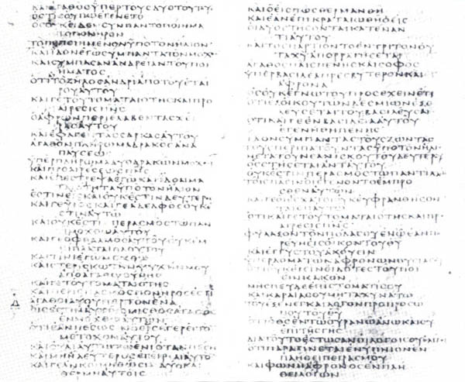
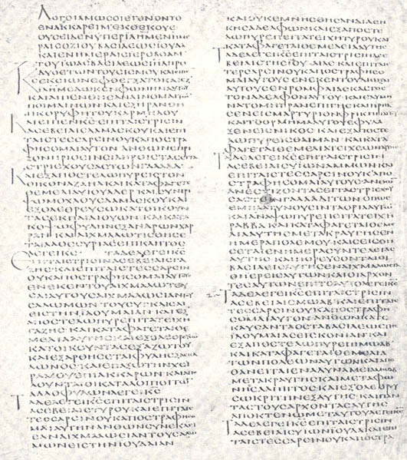
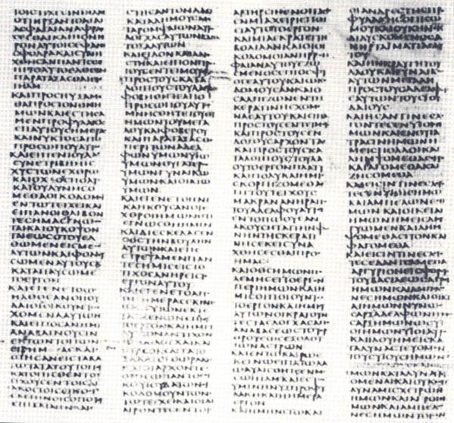
The Septuagint A Greek Translation of Hebrew Law
Famous for their completeness, as well as their antiquity—fourth and fifth centuries A.D.—the beautifully preserved manuscripts called Vaticanus, Sinaiticus and Alexandrinus contain substantial portions of the Septuagint and the New Testament.
Bible Review 5:4, August 1989
Mission To Alexandria

Slide 6
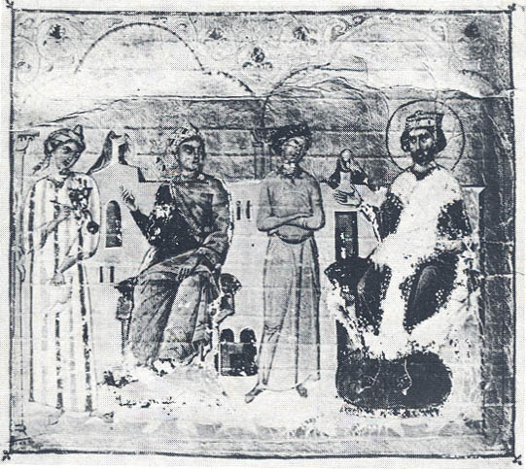
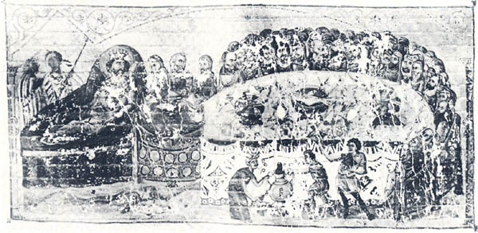
Letter of Aristeas
Ptolemy asks Eleazar to send to Alexandria a delegation of Jewish “elders of exemplary lives” who can translate the Hebrew Bible into Greek. This miniature illustrating the Letter of Aristeas and the miniature on page 37 appear in the opening to a Byzantine Octateuch (the first eight books of the Old Testament) dating to the 11th century.
The 72 elders, six from each tribe, are treated to an elaborate—and kosher—welcoming banquet by their host, Ptolemy, who lounges on couch, left. “Everything of which you partake,” he tells them, “will be served in compliance with your habits; it will be served to me as well as to you” (verse 181).
Bible Review 5:4, August 1989
Mission To Alexandria

Slide 7
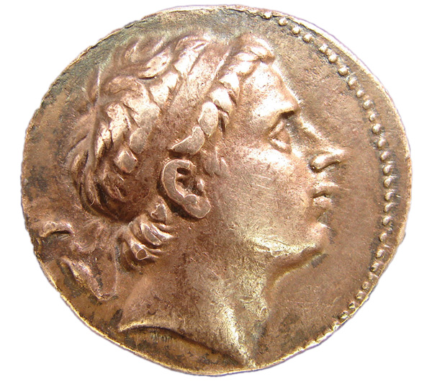
Jerusalem falls under the control of the Seleucids
Antiochus III, successfully wrenched control of Coele-Syria from the Ptolemies of Egypt and remained largely on the margins of Jewish political and religious affairs afterward. His military losses at the hands of the upstart Romans in the west, however, left the Seleucid dynasty with mounting debt.
The busts on these silver tetradrachm coins were directly inspired by much older coins depicting Alexander the Great. Like Alexander, all three Seleucid rulers are shown with flowing locks and wearing a diadem, or royal headband.
Biblical Archaeology Review 34:6, November/December 2008
Inscription Reveals Roots of Maccabean Revolt

Slide 8
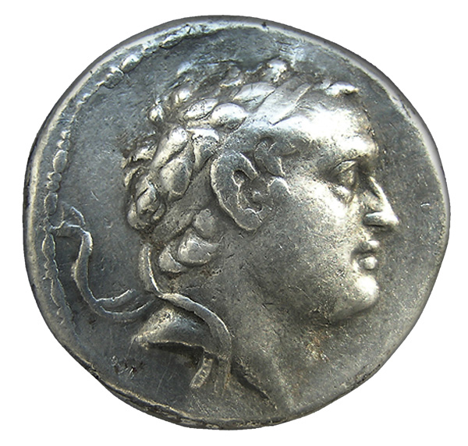
Seleucus IV
During the reign of Seleucus IV , the Seleucids turned increasingly to their Syrian vassals for financial support. As the new inscription indicates, Seleucus took the bold step of involving himself in local religious affairs, no doubt hoping to gain unfettered access to much-needed treasure.
Biblical Archaeology Review 34:6, November/December 2008
Inscription Reveals Roots of Maccabean Revolt

Slide 9
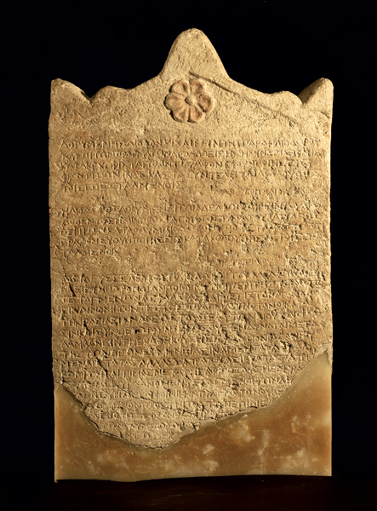
Seleucus IV sends Heliodorus to raid the Temple Treasure
The stela may provide background to a famous episode involving a miracle that is recounted in 2 Maccabees 3. In that account, Simon, the administrator of the Temple, quarreled with the high priest. To get even, Simon told an agent of the king about the “untold sums” in the Temple treasury and that “it was possible for them to fall under the control of the king.” King Seleucus chose Heliodoros, who was in charge of his affairs (apparently the same Heliodoros addressed in our stela), “to effect the removal of the reported wealth.” When Heliodoros arrived in Jerusalem, the high priest told him that the money belonged to widows and orphans. “But Heliodoros, because of the orders he had from the king, said that this money must in any case be confiscated.”
Biblical Archaeology Review 34:6, November/December 2008
Inscription Reveals Roots of Maccabean Revolt

Slide 10
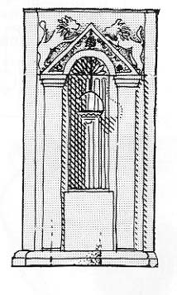
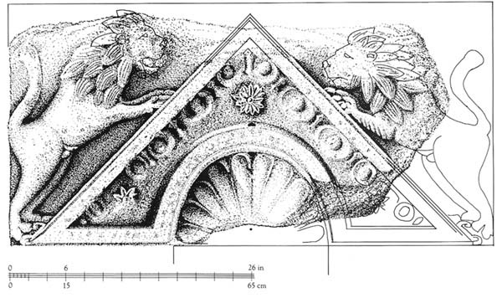
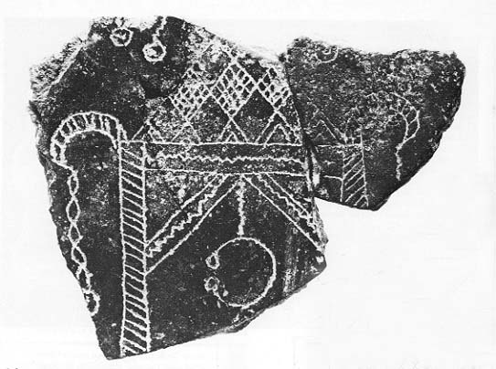
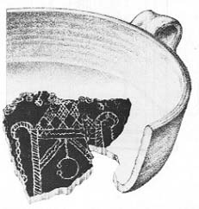
The Eternal Light of the Tabernacle
The ark pediment from the synagogue at Nabratein. In the third century A.D. this 1000-pound carved block of limestone rested on stone pillars; together the pediment and columns formed a shelter for a wooden Torah Shrine. The Torah Shrine protected handwritten Torah scrolls which rested on the shelves inside it. The ark served as the symbolic representation of the former Temple in Jerusalem and of the portable Ark of the Covenant carried by the Israelites in Sinai.
Biblical Archaeology Review 7:6, November/December 1981
Finders of a Real Lost Ark
A fragment of a distinctive black ceramic bowl was discovered at Nabratein. Incised in white on the sherd is a depiction of a Torah shrine.
Notes:
‹#›

